Slide 1
STAYZE RENT PREDICTION
1st Hackathon
By:
Gaurav MahajaN

Slide 2
PROBLEM STATEMENT
- Build a machine learning model to predict the ideal price of the rental properties

Slide 3
POTENTIAL BUSINESS PROBLEMS
Set optimum prices so as to ensure travelers' as well as hosts’ satisfaction
Decide upon marketing initiatives and budgets to garner customer inflow
Study traveler and host behavior on the platform
Who are the stakeholders?
CEO
Chief Strategy Officer
Chief Financial Officer
VP Sales and Marketing

Slide 4
WHY SOLVE THIS PROBLEM?
Business Impact
Improve prediction -> gain business insights, make decisions, improve security
Improve prediction -> understand the customers' and providers' (hosts) behavior and performance on the platform
Improve prediction -> identify right target audience-> guiding marketing initiatives
Improve prediction-> implementation of innovative additional services
and much more

Slide 5
DATA
Dataset Information: The data consists of records of roughly 34500 properties and 15 features.
Id | listing ID
name | name of the listing
host_id | host ID
host_name | name of the host
neighbourhood_group | location
neighbourhood | area
latitude | latitude coordinates
longitude | longitude coordinates
room_type | listing space type
price | price in dollars
minimum_nights | amount of nights minimum
number_of_reviews | number of reviews
last_review | latest review
reviews_per_month | number of reviews per month
calculated_host_listings_count | amount of listing per host
availability_365 | number of days when listing is available for booking

Slide 6
EVALUATION METRIC
The evaluation metric for this project is RMSE score.
Ideal solution would be the one which:
has low root-mean-squared error (RMSE) based on cross-validation
can be reproduced and interpreted.

Slide 7
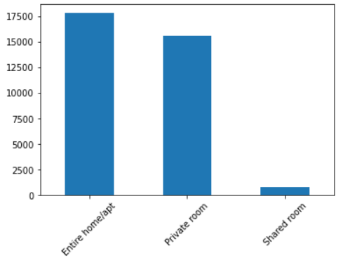

FIRST STEPS - EDA
This is the univariate analysis of the room types based on their price
The plot shows the entire home/apt properties are the costliest followed by private rooms and the shared room being the cheapest, which is quite obvious as well.

Slide 8
PIPELINE
Outlier treatment :
The Outliers in the continuous features were detected and treated using Quantile approch

Slide 9
PIPELINE
Missing Values:
There were no missing values in crucial fields viz. id, host_id, neighbourhood, neighbourhood_group, room_type, price and minimum_nights.
There were some missing values in name and host_name represented as NaN which were replaced by the name called “Anonymous Place” and “Anonymous Name” as it was not able to recovered from ‘id’ and ‘host_id’
There were 6982 missing values each in last_review and reviews_per_month represented as NaN but for each, the number of reviews were 0.

Slide 10
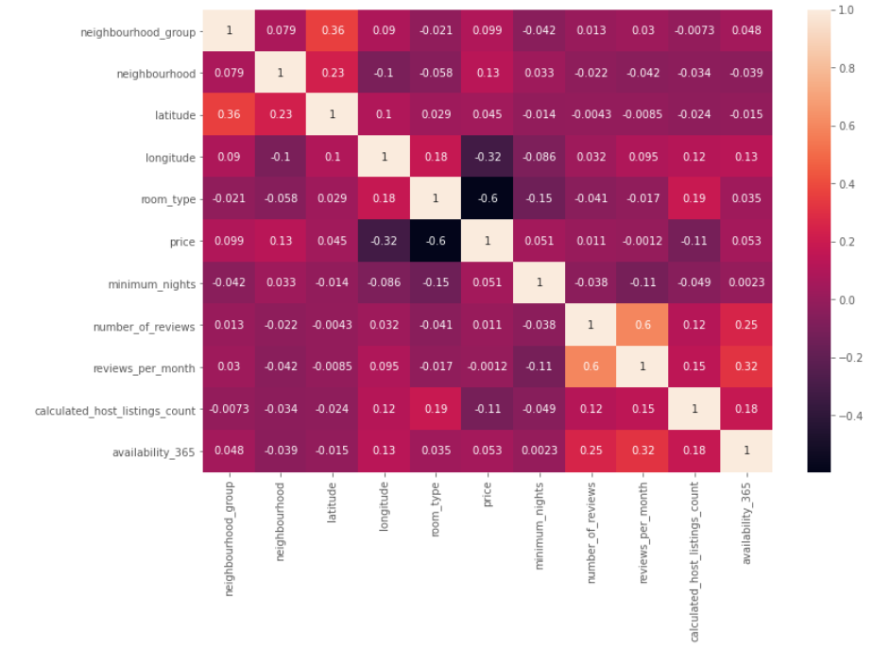
PIPELINE
Correlation methods were used to check the dependability of variables with each other:

Slide 11
MODELS AND APPROACHES Three models were used for machine learning: 1. Linear Regression 2. Lasso 3. Random forest classifier

Slide 12
EVALUATION & RESULTS
Below are the RMSE results for all the models
Parameters | RMSE | R2 Score | Min absolute Error
Models
Linear Regression | 49.72 | 52.06 | 59.19
Lasso | 0.43 | 0.37 | 0.19
Random Forest classifier | 37.15 | 39.45 | 42.12
The RMSE results for linear regression was lowest in all of 3 models

Slide 13
INSIGHTS & DECISIONS
Ideal price for properties in this neighbourhood
Various holiday packages as per neighbourhood
Loyalty program
Additional services in premium properties
Pick up and drop service
Complementary breakfast and lunch
Membership offers

Slide 14
NEXT STEPS
If time permitted, we could have tried the following :
● Better feature engineering
● An ensemble of different models
● A UI for a real user

Slide 15
THANK YOU

